Slide 1
Unit 1 Legal Studies
Head Start Program

Slide 2
Ms Manson contact details
Staffroom: Commerce 2 (opposite Room 23)
Email: manson.elyse.e@edumail.vic.gov.au

Slide 3
Expectations
All school rules apply in this classroom, in particular:
Punctuality, preparedness, respect, effort all the time!
All set homework is to be completed and graded - 0,1,2 marking scale
No phones or iPods, MP3s etc.
Lateness
Absences
Email etiquette
Water bottles
Use of planner
Lining up

Slide 4
Class introduction
Please introduce yourself with:
Your name
Something you like to do/eat that also begins with the first letter of your name
The reason you chose to study Legal Studies this year or what you are hoping to learn about in the subject

Slide 5
Areas of study
A of S 1: Law in society
A of S 2: Criminal law
A of S 3: The criminal courtroom
The main focus in Unit 1 is on why we need laws, how they are made and crime and criminal process
Handout 1: Unit 1 student checklist

Slide 6
Assessment
Each area of study will have at least one major assessment task to complete. These are known as SAC (school-assessed coursework) tasks
They will be things like tests, research assignments, case studies, presentations, folio and reports, and an end of semester/year exam
Handout 2: Course outline and assessment

Slide 7

Requirements
In Unit 1 Legal Studies you will need:
To purchase the text book:
  - ACCESS and JUSTICE 11th ED
A well-organised work book and loose leaf paper to submit work in on
To maintain and keep all class notes
If you are absent you will need to catch up on what you have missed – it is your responsibility to contact your teacher in person or via email
To complete all homework consistently as this will be part of your assessment

Slide 8


Slide 9
Requirements (continued)
You will also need to keep up to date with criminal law and civil law issues in the media, by frequently utilising and interacting with:
newspapers
news programs
internet sites of relevance etc.

Slide 10

Glossary of terms
You will all need to maintain a glossary of legal terms that will act as a dictionary for you
Do not just copy the terms from the text book. When you come across a new legal term you will need put this term into your own words as much as possible
Handout 3: Glossary instructions

Slide 11
Task words
Handout 4: Key task words (will assist you in SAC tasks and your examinations)
It is very important that you carefully read and answer the question; don’t simply write everything you know about the topic
e.g. ‘describe one aim of criminal sanctions’ is asking something very different to ‘evaluate the effectiveness of one aim of criminal sanctions’

Slide 12
Area of study 1:
Law in society
So what are laws?
Why do we have them?
What purpose do they have?
What makes them effective?
How are laws different?
All these questions seem very simple – do you know the answers?

Slide 13

So what then is the difference between legal and non – legal rules?
Who must obey them?
Who makes the rule?
Who enforces the rule?
Who interprets the rule?
Copy table p. 3 textbook

Slide 14

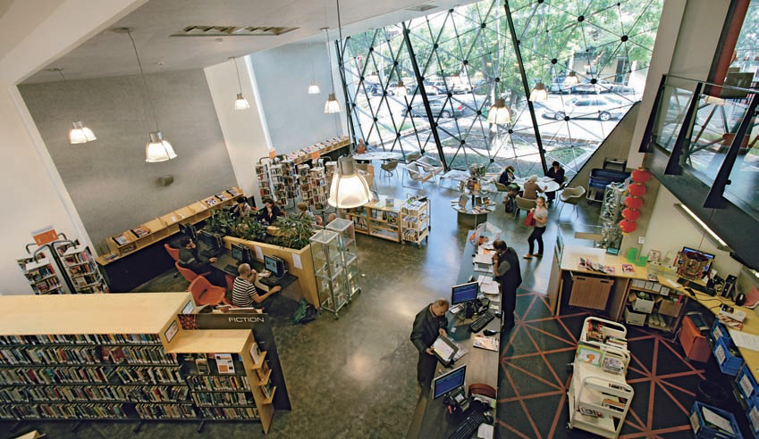

What are the laws/rules that govern these activities?

Slide 15
Features of laws
Who made the law/rule?
Who enforces it?
How are they enforced?
What is the penalty?

Slide 16


Joe’s story
Handout 5: Joe’s Story – A case study
Read the story and answer the questions

Slide 17
Joe’s Story
a)
Legal rule | Non-legal rule
Lunch break at work | Punctuality at work
Noise pollution | $60 board p/week
Domestic violence | Chores
Speed limit | 10.00pm curfew
‘No entry’ lane | Hands on player’s back
Theft of Mars bars | Tripping and kicking
Wrestling | Wrestling
Theft of hubcaps | Touch ball on the line

Slide 18
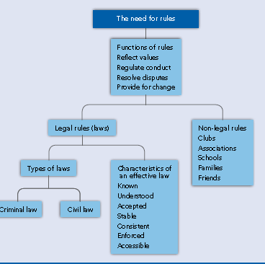

Slide 19
Questions:
1. If there were no rules in our society, then society would still function as it does now. AGREE/DISAGREE
2. If there were no rules in society, then most people would live without fear or threat to their personal safety. AGREE/DISAGREE

Slide 20
3. If there were no rules in society, then most people’s possessions would be safe. AGREE/DISAGREE
4. If there were no rules in society, then most people would behave as they do now. AGREE/DISAGREE

Slide 21
5. If there were no rules in society, then people would still be able to sort out their conflicts. AGREE/DISAGREE
6. The human race is basically ‘good’ by nature, so there is no need for rules in our society. AGREE/DISAGREE

Slide 22
7. If there were no rules in society, then humans would use their animal instincts to survive. AGREE/DISAGREE
8. If there were no rules in society, then I could do whatever I wanted.
  AGREE/DISAGREE

Slide 23
9. If there were no rules in society, then I would be fearful most of the time.
AGREE/DISAGREE
10. If there were no rules in society, then there would be no way I would go to school or do any work.
AGREE/DISAGREE
11. If there were no rules in society, then we would live in chaos.
AGREE/DISAGREE

Slide 24
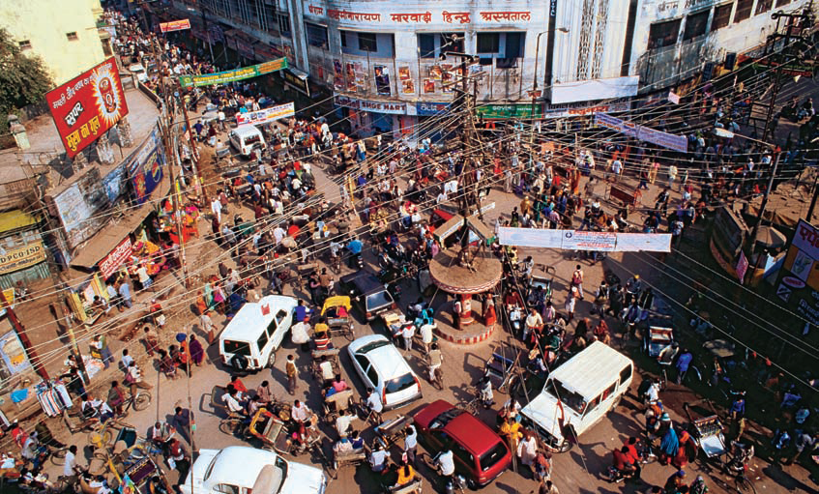
Chaos!!!

Slide 25
Weebly website
rsclegal.weebly.com
Ch. 1 of textbook
Handouts
Email access
Holiday homework

Slide 26
How easy is it to make a rule/ law?
Handout 5: No rules
Working in groups of 3-4 you are to devise a new set of school rules
You need to determine all the rules and outline:
Who it applies to
Who will apply the rule
When it applies
Penalties for breaches of the rule
How the rules reflect the values of the school you want to have
Further questions
Why did you decide on the rules that you have and the penalties?
What has been the most challenging part of the task?

Slide 27
What makes a law effective?
1. It must be known to the public. If people don’t know about a law then they can’t follow it e.g. new laws related to abortion in Victoria where widely debated
and
It must be able to be understood. A law cannot be followed if people do not understand it e.g. road traffic laws need to be easy for drivers to follow

Slide 28
2. It must be acceptable to the community. The law must be in line with values in the community e.g. shop trading hours and wearing of seat belts in cars
3. It must be able to change to meet changing demands in society. Values change and the law must keep up with this e.g. advancements in technology (medical and social)

Slide 29
4. It must be stable. If the law was to change too often then there would be chaos. So it must be able to change but not too much that it causes confusion e.g. what if the road rules changed when we had a change in government?
5. It must be enforced. If someone breaks the law then it must be possible to bring that person to justice e.g. no point in having traffic laws if they are not policed

Slide 30
Laws: Fact or fiction?
A. It is illegal to eat cats and dogs. FACT/FICTION
B. It is illegal to sing an obscene song, tune or ballad within earshot of someone. FACT/FICTION
C. If you meet up with a pirate, it is illegal to trade with them. FACT/FICTION
D. If you fly kites or play a game in public which annoys another person, you could be fined. FACT/FICTION
E. It’s an offence to drive a dog or goat harnessed or attached to a vehicle in a public place. FACT/FICTION
F. When walking on a footpath, you must walk on the left side. FACT/FICTION

Slide 31

Laws: Fact or fiction?
Use the Summary Offences Act and the Crimes Act to research whether these laws are true or not
What other strange laws can you find?

Slide 32
Strange laws
A. There is no law that specifically prohibits the eating of cats or dogs in Victoria (there is in SA under the Summary Offences Act 1953). However, the killing of cats or dogs for such purpose may constitute an offence under Prevention of Cruelty to Animals Act 1986. Processing and selling cat or dog meat is prohibited under Meat Industry Act 1993
B. If you can be heard by someone while singing an obscene song, you'll be in trouble (Summary Offences Act 1966)
C. You may not trade with Pirates (Crimes Act 1958)
D. You may not fly kites or play games in public that annoy other people (Summary Offences Act 1966)
E. Its an offence to drive a dog or goat harnessed or attached to a vehicle in a public place (Summary Offences Act 1966)
F. It is against the law to walk on the right hand side of a footpath (Summary Offences Act 1966)

Slide 33
Other strange laws
Only licensed electricians may change a light bulb
Keys may not be left in unattended vehicles (Road Safety Regulations 1999)
People may not come within 100 meters of a dead whale carcass (Summary Offences Act 1966)
It is illegal to read someone's tarot, or give them a psychic reading as these are forms of witchcraft (Repealed, 2005)
Being near or in a house that is regularly used by thieves can get you arrested (Vagrancy Act 1966)

Slide 34
Laws and legislation web-quest
Handout 6: Laws and legislation web-quest
Parliament and laws they have made: log on to http://www.legislation.vic.gov.au/
Go to ‘Victorian Statute Book’
Row Title Act Number

Slide 35
Civil and Criminal law
What are the differences?
Make a list of laws that you can think of and then classify what type of law you think it might be
A criminal or a civil issue?
Do you know the difference?

Slide 36
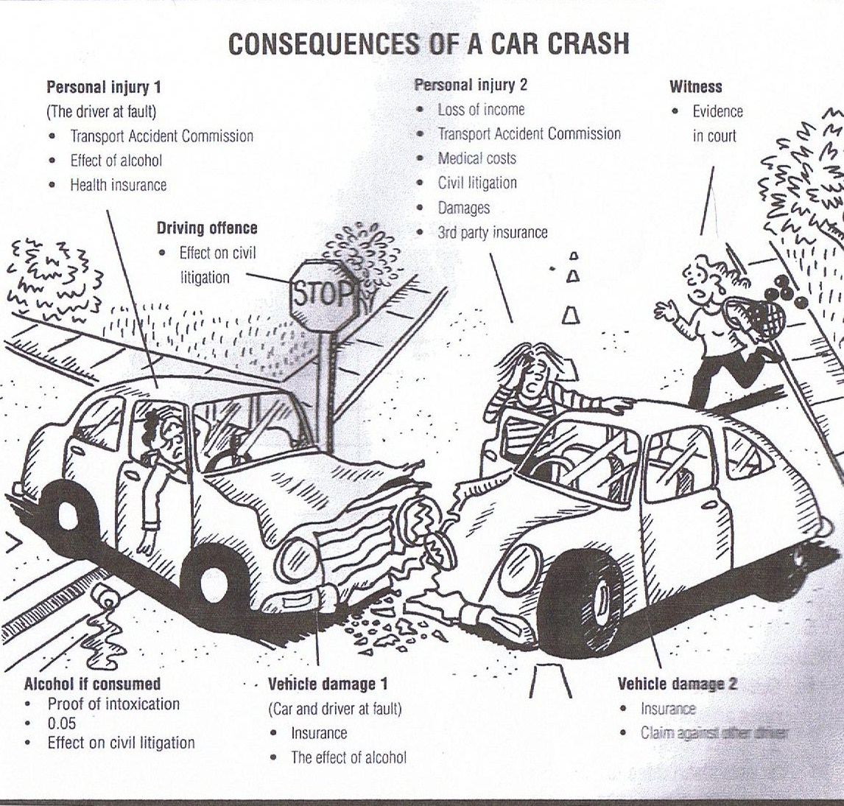

Slide 37
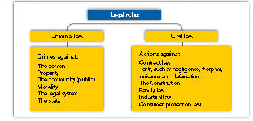

Slide 38
Key differences between civil and criminal law
Handout 7: Distinction between criminal law and civil law

Slide 39
Case studies
Read the case studies on Handout 7 and answer the questions:
1. Schoolgirl wins landmark assault case
2. Shopkeeper sued
3. Shoplifter in court
4. Compensation paid for capsicum spray damage
For each case study, identify the terms that indicate whether the case is civil or criminal

Slide 40
Different types of laws
We already know that laws can be either criminal or civil
Laws can also be classified as to the source of law
What are the sources of law?
Laws made by parliament – statute law
Laws made by the courts – common law
Laws made by statutory authorities – delegated legislation

Slide 41
Quick thinking task
In groups:
1. Suggest 5 possible changes to our community attitudes in the next 20 years. How might these influence the law?
2. Think of 5 new and creative ways to overcome crime

Slide 42

Holiday homework
Complete all handouts (which you should have already done during class time!)
Set up/update your glossary (see suggested terms on Weebly site)
Read through Ch. 1 of textbook (available at rsclegal.weebly.com)
Complete Learning Activities:
1.5 p. 16 Qs 1-9
1.6 p. 20 Qs 1-7
1.7 p. 23 Qs 1-5
1.8 p. 26 Qs 1-3

